Slide 1


Final Project— Whole Gyms
Northeastern University GOAT

Slide 2





CONTENTS
Project Overview
Eco-System Diagram
UML Diagram
Roles & Capabilities

Slide 3

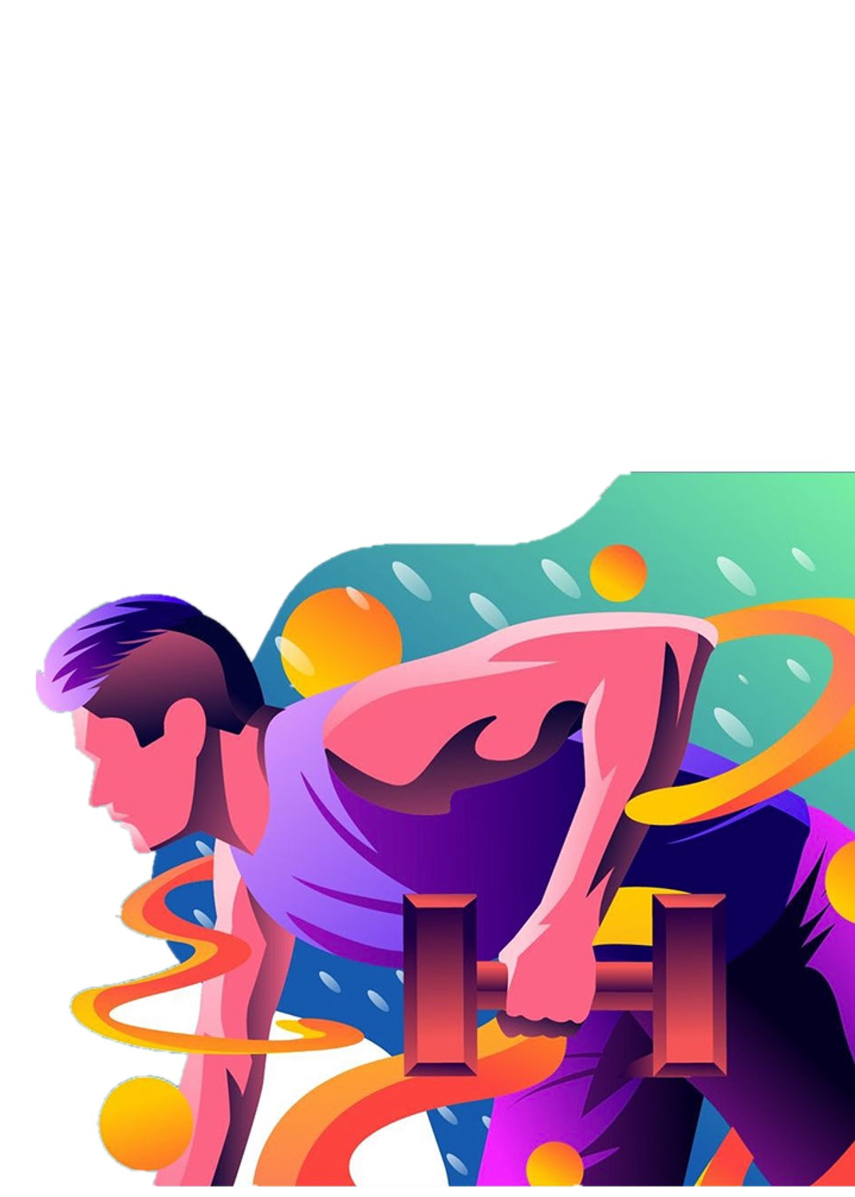
Project Overview
What’s the system used for? Which issue it has solved? How it has solved the issue?

Slide 4


What’s the system used for?
Whole Gyms—A gym management system: 1) Manage some enterprises within the system, such as fitness companies, markets, and physical therapy institutes; 2) Provide customers with a platform to book fitness classes, personal coaches, physical therapy, and food.

Slide 5


Which issue it has solved?
Customers: it can avoid time conflicts, ensure adequate food supply, and help them manage their time properly;
Fitness Companies: it results in labor savings;
Other Cooperation: it helps them build a solid working relationship with the fitness companies to boost sales.

Slide 6
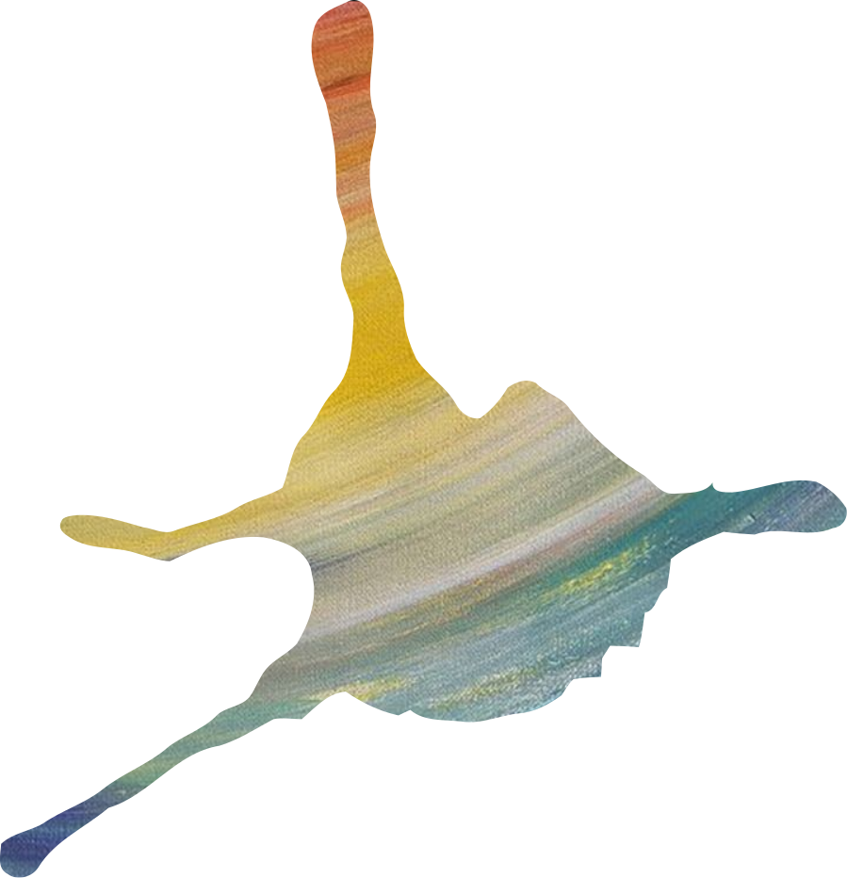
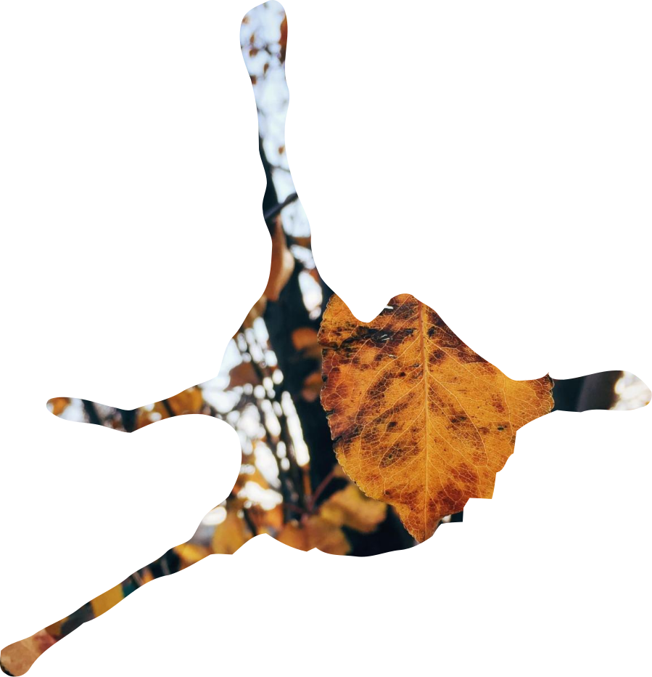
Eco-System Architecture Diagram

Slide 7
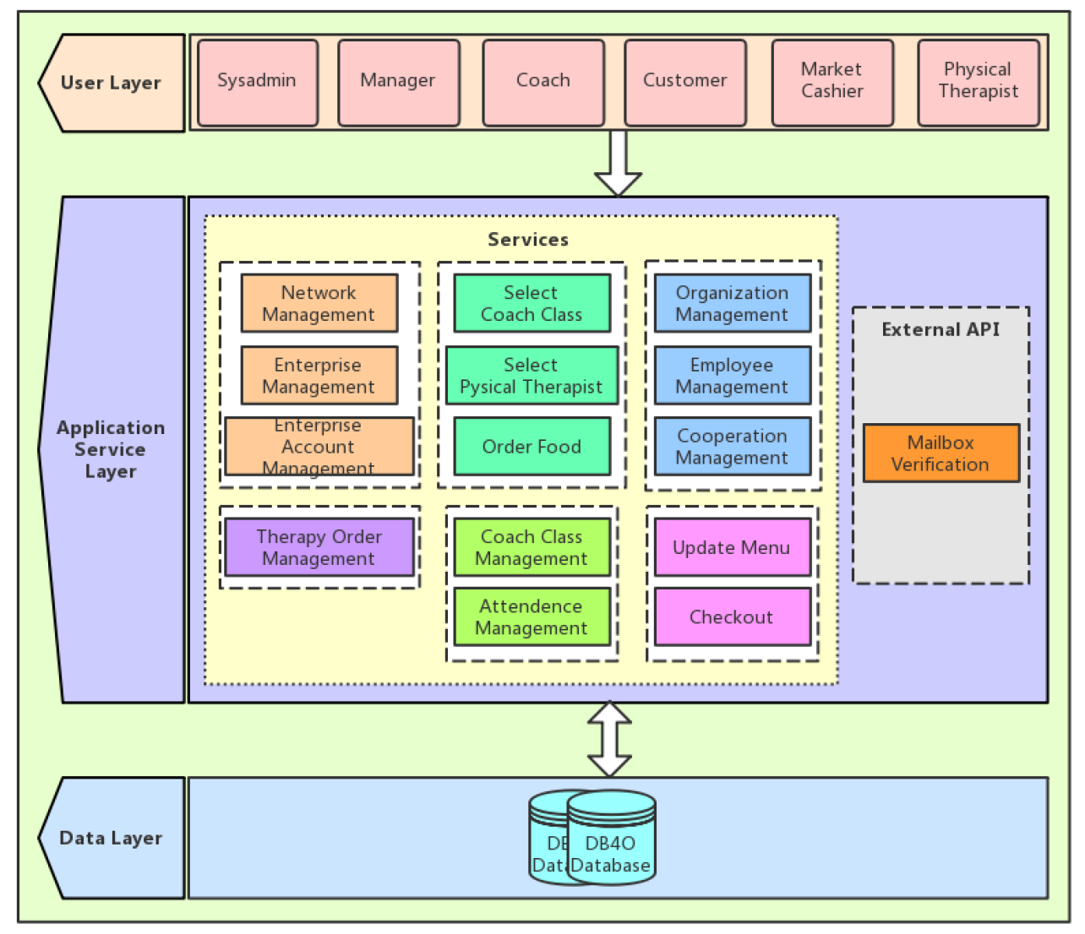

Slide 8


UML Diagram
Three enterprises:
Fitness Companies, Market, Physical Therapy Institute.
Five organizations: Customer Organization, Market Cashier Organization, Fitness Coach Organization, Manager Organization, Physical Therapist Organization.

Slide 9
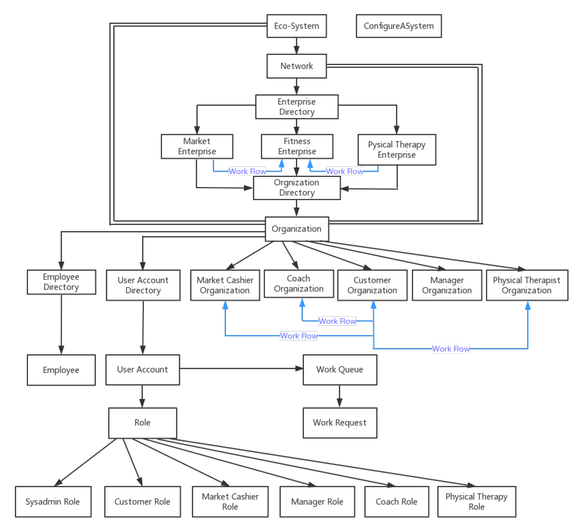

Slide 10
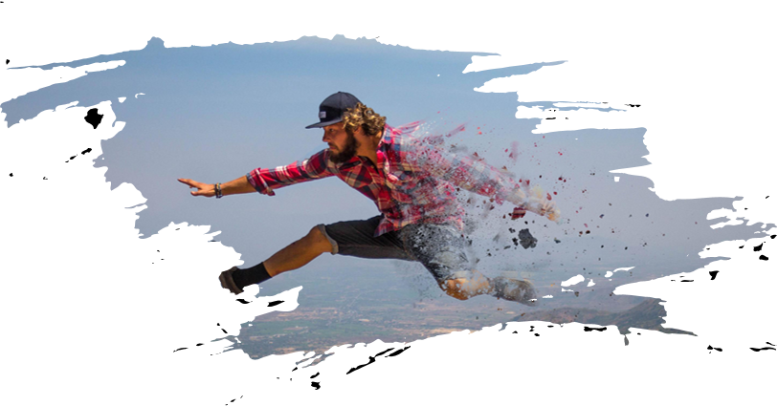

Six roles: Sysadmin, Market Cashier, Manager, Physical Therapist, Customer, Fitness Coach.
Roles & Capabilities

Slide 11

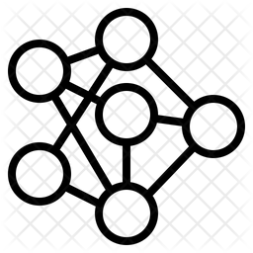



Network Management
Roles—Sysadmin
Enterprise Management
Enterprise Account
Management
Create and delete networks
Create and delete enterprises in the designated networks.
Create and delete enterprises managers in the designated enterprises and networks.

Slide 12
Market Cahier
Physical Therapist
1) Update the menu; 2) Process orders.
Roles
Fitness Coach
Customer
1) Pre-order fitness classes, physical therapy, and food; 2) Manage the ordering classes, therapy, and food
Manager
Manage Organizations;
Manage Employees;
Manage Cooperation.
Manage the ordering therapy.
Manage coach classes;
Manage attendance;

Slide 13
THANKS
POWERPOINT DESIGNED BY GOAT

